Slide 1
Manipulating strings
CS 3335, Fall 2017
Dr. Zhiguang Xu

Slide 2
subjects
A quick review of strings
Array of strings
String-related functions in the C standard library
Formatted I/O with printf() and scanf()
Note: sprintf() is similar to printf() except that its target is a string; sscanf() is similar to scanf() except that its source is a string.

Slide 3
A quick review of strings
Array of characters
Sentinel symbol ‘\0’
sizeof()
String literals
String variable vs. Pointer to char

Slide 4
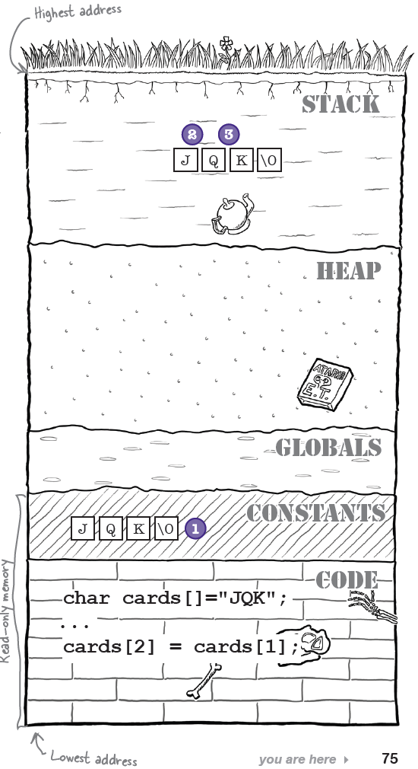
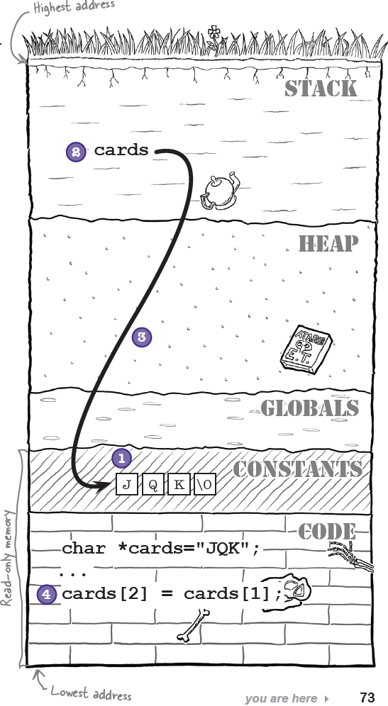
A closer look at strings
char *cards = “JQK”; //A string literal
cards[2] = cards[1]; // Wrong!
char cards[] = “JQK”; //Make a copy
cards[2] = cards[1]; // fine
* Assuming the code above is inside a function.

Slide 5
A closer look at strings
Make sure you understand the difference between
char cards[] = “JQK”; // size = 4 with ‘\0’
char cards[] = {‘J’, ‘Q’, ‘K’};// size = 3
The compiler will help you if you explicitly make the contents of the storage that your pointer points to constant: const char *cards = “JQK”;
// Compiler error on next line: assignment of read-only location
cards[2] = cards[1];
Make you understand the difference between
const char *cards = “JQK”;
char * const cards = “JQK”;
So, cards[] or *cards? See “Geek bits” on page 74.

Slide 6
Array of strings
Array of arrays char tracks[][80];
Array of pointers char *tracks[];
Ex. Command line arguments to the main function (chapter 3, page 141, we will talk more about it later.) int main(int argc, char *argv[])

Slide 7
Useful functions in the C standard library
#include <string.h>
strchr(), strrchr(), strchrnul()
strcmp(), strncmp()
strstr(), strcasestr()
strcpy(), strncpy()
strlen()
strcat(), strncat()
strtok()
…
#include <stdlib.h>
Convert a string to an integer: atoi(),atol(),atoll()
Convert a string to a floating point number: strtod(), strtof(),strtol()
…

Slide 8
Formatted output
int printf(const char *format, …)
format: a string that contains text with embedded conversion specs to be written to stdout
Conversion specs
Returns # of characters printed
http://www.cplusplus.com/reference/clibrary/cstdio/printf/
sprintf() and fprintf()
% | [flags] | [field width] | [.precision] | [length modifier] | specifier
 | +, -,’ ‘, #, 0 | Min width of the converted argument | Min number of digits | h, l, L | d, i, o, u, x, X: integers
 |  |  | Number of digits after the decimal point |  | e, E, f: floating point
 |  |  | Max number of significant digits |  | g: shorter of %e or %f G: shorter of %E or %f
 |  |  | Max number of characters |  | S: string

Slide 9
Formatted input
int scanf(const char *format, …)
format: a string that contains
white spaces (including whitespace, newline, and tab): skip any number of whitespaces in the input stream
ordinary (non-whitespace) chars: must match
Conversion specs
Skips white spaces unless reading a character with %c
Returns number of successful conversions
http://www.cplusplus.com/reference/clibrary/cstdio/scanf/
sscanf() and fscanf()
% | [*] | [width] | [modifiers] | type
 | Results of the conversions are not assigned to any variables | Max number of chars to read | h, l, L | c, d, e,E, f, g, G o, s, u x, X

Slide 10
Formatted input
An example:
char c, *cntrl_string, save[7], store[15];
int a, cnt;
cntrl_string = “%d , %*s %% %c %[abc] %*s %5s %s”;
cnt = scanf(cntrl_string, &a, &c, save, store, &store[5];
With the following charcters in stdin:
23 , ignore_this % C abacus read_in_this**
Results:
a = 23, c = ‘C’,
“abac\0” in save[0] through save[4], “read_\0” in store[0] through store[5],
and “in_this**\0” in store[5] through store[14] (I,e, ‘\0’ in store[5] is overwritten by ‘i’)
A string that contains any of these three chars

Slide 11
Be careful with scanf()
tryscanf.c
Good
char f_n[20];
char l_n[20];
printf(“Enter first and last name: “);
scanf(“%19s %19s”,f_n, l_n);
// First name and last name can not contain whitespaces though.
Buffer overflow
char food[5];
printf(“Enter favorite food: “);
scanf”%s”,food);
// Trouble (overflow) if more than 4 characters are received
Use fgets() as alternative (tryfgets.c)
char food[5];
printf(“Enter favorite food: “);
fgets(food, sizeof(food), stdin);
// Only receive up to 4 chars, “\n” included
// To remove “\n”:
// if (strstr(food, “\n”))
// food[strlen(food) -1]=‘\0’;
scanf() vs. fgets(): page 68.

Slide 12
Examples
Pool puzzle on page 94.
Code Magnets on page 97.
And more…

